Slide 1
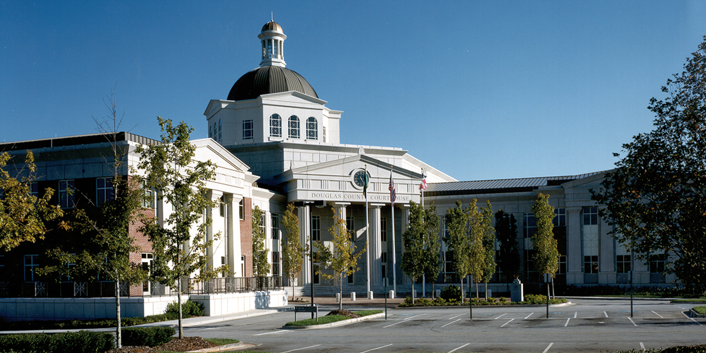





DOUGLAS COUNTY
GEORGIA
DOUGLAS COUNTY BOARD OF COMMISSIONERS
PRESENTATION OF THE PROPOSED MILLAGE RATE FOR THE 2024 TAX YEAR

Slide 2




TABLE OF CONTENTS
Recap of Financial Condition 3
Millage Rate and Budget Allocation 4
5- Years Tax Digest History 6
Net Digest vs Millage Rate Historical Comparison 7
Tax Calculation Examples 8
FY 2024 Millage Schedule 12

Slide 3


RECAP OF FINANCIAL POSITION
The County has no outstanding debt obligations
The County has maintained a fund balance in compliance with BOC policy
The County is embarking on a reinvestment strategy to address the County's aging equipment and infrastructure
The County is focused on sustainable economic growth and fiscally prudent development initiatives

Slide 4
SUMMARY FY2024 GENERAL FUND MILLAGE RATE BUDGET ALLOCATION

Slide 5
Overall County vs School Millage Rate Allocation
Proposed Millage
BOC | 12.313
School Plus 0.5 mil. for School Bond | 19.400
Total | 31.713

Slide 6
5- Years Historical Property Tax Digest

Slide 7
Net Tax Digest vs Millage Rate Historical Comparison

Slide 8
Millage Rate Ratio Per Net Digest Value

Slide 9
Douglas County Millage Rate w/o Roll Back
Douglas County Millage Rate with out Roll Back
2024 Net Digest | $7,051,596,393
Proposed Millage Rate (same as last year) | 0.012313
 | $86,826,306.39
Douglas County Millage Rate with Roll Back
2024 Net Digest | $7,051,596,393
2024 Digest Roll Back Millage Rate | 0.012081
 | $85,190,336.02
Difference | $1,635,970.37

Slide 10
2024 Household Tax Rate Comparison With vs W/O Rollback

Slide 11
2024 Household Tax Rate Comparison With vs W/O Rollback

Slide 12
FY 2024 MILLAGE RATE TIMELINE
EVENT DATE TIME
First Public Hearing | Tuesday, August 20, 2024 | 10:00 a.m.
Second Public Hearing | Tuesday, August 20, 2024 | 6:00 p.m.
Third Public Hearing & Adoption | Tuesday, August 27, 2024 | 10:00 a.m.
Adoption of the Millage Rate | Tuesday, August 27, 2024 | Following the third Public Hearing

Slide 13




Douglas County Board of Commissioners
Thank you

